Slide 1
Cyber Security Capture the Flag Competitions
An overview of how I completed the 2015 Ghost in the Shellcode challenge

Slide 2
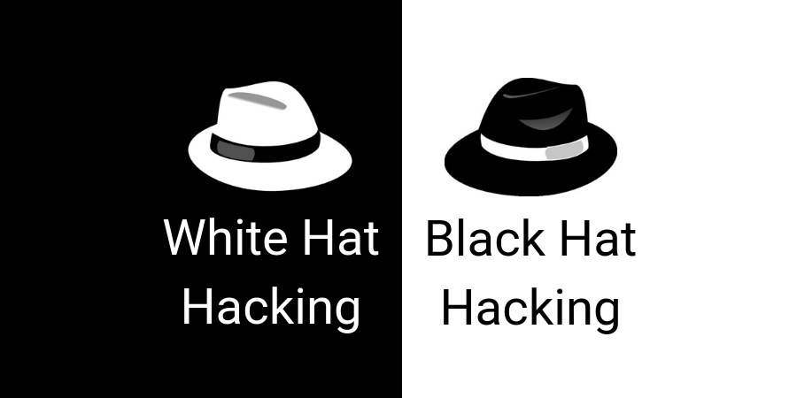


Cyber Security Expert - discloses vulnerabilities
Hacker cat – no ethics. Don’t mess with him.

Slide 3
Why Security matters
News extracts from the last month:
US military Cyber Command claim that they have been deploying malware inside Russia grid and claim it can cripple Russia’s power network.
~The New York Times 15/6/2019
It has been revealed that customs in the Xinjiang region China are installing text-stealing malware at their border.
~VICE 3/16/2019
A Florida city paid a $600,000 bitcoin ransom to hackers who took over their computers
~Business Insider 20/6/2019
The Iranian company Cellebrite claim they have found an exploit that can unlock any iPhone for the police force.
~WIRED 14/6/2019
+ 60 other news worth events that took place in June relate to cyber security.

Slide 4
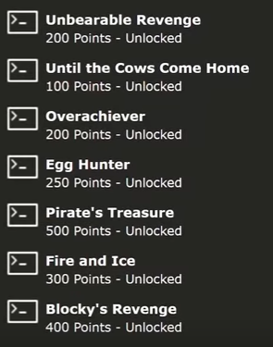

So what is a cyber security Capture The Flag (CTF) competition?
A security CTF is:
Solve challenges – reverse engineering challenges, crypo challenges, exploits challenges, etc
Collecting flags – collecting an item or password as the reward for completing each challenge
Win -team with the most flags in a given time limit wins.
2015 Ghost in the Shellcode CTF:
Made game ”Pwn Adventure 3 – Pwnie Island”
Goal is to complete 7 quests (look above)
Collect flag for each quest you complete.

Slide 5




How long did it take me to complete?
CTF when for 2 day
But that was for a team of cyber security professionals
i.e. People that know what they are doing
It took me 5 months
Had to take 3 online courses to prepare
Introductory intel x86: architecture, assembly, applications, & alliteration
Introductory intel x86-64: architecture, assembly, applications, & alliteration
Introduction to software exploits (exploits 1)
Learn how to use a bunch of tools:
GDB for disassembly
Binary ninja for reverse engineering executables
LD preload for injecting code
Plus more – e.g. Wireshark for network analysis

Slide 6

So finish the quests - collect the flags. How hard could that be….

Slide 7
Turns out it is pretty hard
Let me walk through 1 of the 7 challenges.
Challenge: egg hunter
Collect the 10 golden eggs in the game to get the egg hunter flag
The golden eggs are hidden in the game (e.g. In caves, behind buildings and in unreachable places)

Slide 8
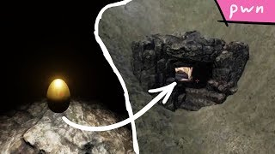
What the eggs looks like:

Slide 9

How would you find the hidden eggs?
Find the X, Y, Z coordinate of the eggs
Walk in the direction of the eggs
Collect them

Slide 10
But how can we do that?
When a game launches it will build the world and place objects into that world.
We can check the initialization section of the game to see if it places the golden eggs into the world (spoiler it does).
We can then write down the x, y, z coordinates and then walk to each egg.
We can use a disassembler such as binary ninja or ida pro to do all of this.

Slide 11
Gotta Catch 'Em All!
Once we know where the eggs are -> can start collecting the eggs
But some eggs are not accessible (e.g. On a shelf too high to reach)
How to we reach these eggs?
Answer = teleportation

Slide 12
Teleporting
The game holds the player’s X, Y and Z coordinates in memory
If we can find this part of the memory then we can try changing the numbers to whatever we want and see what happens.
How would you find the memory responsible for this?
Record memory -> move player forward -> compare differences in memory
Look at what code is execute when pressing an arrow key -> follow until it writes to memory

Slide 13
Putting it all together

Slide 14
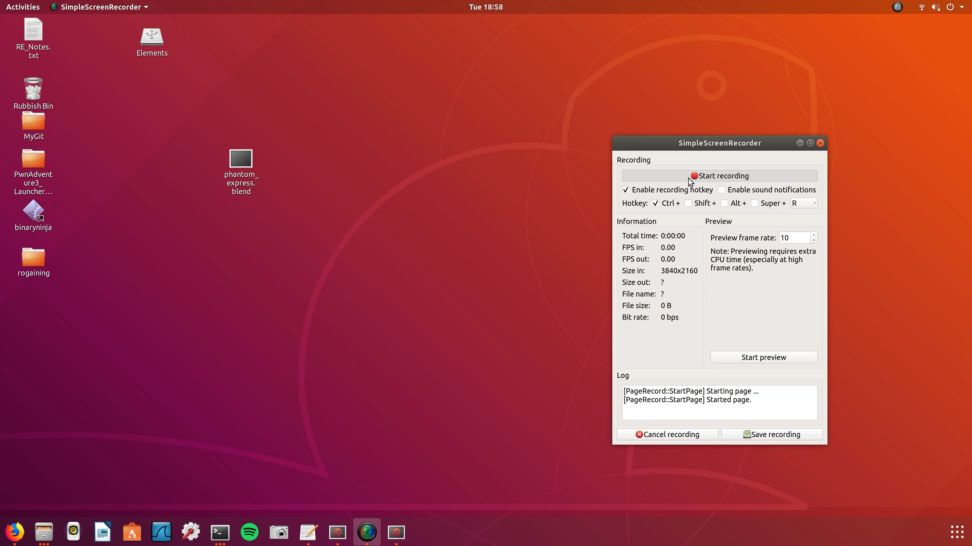

Slide 15
What did I learn from doing this:
There are many tools that make reverse engineering programs easier:
GNU debugger (GDB)
Binary ninja
Dependency walker
IDA pro
Do CTFs are a fun way to apply knowledge and learn new skills.
They are not just for cyber security professionals.
Reverse Engineering
Reverse Engineering
Reverse Engineering
Reverse Engineering
Crypo
Exploit
Machine Learning

Slide 16
What is next?
More CTFs
Currently doing google CTF 2016
Complete 2 challenges so far
Entered into Boss Of The SOC CTF
Uses the log management program Splunk to solve previous security related incidents.
Get more involved in the cyber security community
Joint Cyber Security Centre
Other events

